Slide 1
IT 1724 Geographical Information Systems
Prof. HKD Sarma
Department of IT, SMIT

Slide 2
OBJECTIVE: To introduce the concepts, principles and theories behind a Geographic Information System with emphasis on the nature of geographic information, data models and structures for storing geographic information; Geographic data input, data manipulation, and spatial analysis and modeling techniques are to be understood.
Text Book:
An Introduction to Geographical Information Systems, Ian Heywood, Sarah Cornelius, Steve Carver, 2010, Pearson Education.

Slide 3
What is spatial data ? →Spatial data, also known as geospatial data, is a term used to describe any data related to or containing information about a specific location on the Earth's surface.
→ Geographical Information Systems (GIS) and Geospatial Data are in the core of this study.

Slide 4
Need to Answer various Questions about….
Location…
Patterns…
Trends…
Conditions…

Slide 5
GIS is useful here…..
Location:
→ Where is the nearest book shops?
→ Where are stone age settlements located in Europe?
→ Where are areas of forestry in which Rudrakhs trees are found?
Patterns:
→ Where do high concentrations of students live in the city?
→ What is the flow of traffic along this motorway?
→ What is the distribution of crime incidents in New Delhi?

Slide 6
GIS is useful here…..
Trends:
→ How are patterns of retailing changing in response to the development of out-oft-town superstores?
→ Where have glaciers retreated in the European Alps?
→ Where have changes to the population of polar bears occurred?

Slide 7
GIS is useful here…..
Conditions:
→Where can I find holiday accommodation that is within 1 km of a wind surfing beach and accessible by public transport?
→ Where is there flat land within 500 m of a major highway?
→ Where are there over 1 00,000 potential customers within a 5 mile radius of a railway station?

Slide 8
Defining GIS
Definitions of GIS cover three main components:
→GIS is a computer system
→GIS uses spatially referenced or geographical data, and
→GIS carries out various management and analysis tasks on these data including their input and output.

Slide 9
Capabilities of well-designed GIS:
Quick and easy access to large volume of data
The ability to:
→select detail by area of theme
→link or merge one data set with another
→analyse spatial characteristics of data
→search for particular features in an area
→update data quickly and cheaply
→model data
3. Output capabilities tailored to meet particular needs.

Slide 10
Components of a GIS:
→ Computer systems and software
[High power processor/sufficient memory/high resolution colour graphics screen/data input and output devices.]
→Spatial data
→Data management and analysis procedure
→People / Organizations

Slide 11
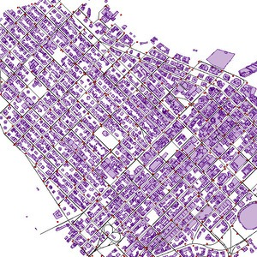
Spatial Data: Maps and their influence

Slide 12
Vector
Vector data is best described as graphical representations of the real world. There are three main types of vector data: points, lines, and polygons. Connecting points create lines, and connecting lines that create an enclosed area create polygons.
Vectors are best used to present generalizations of objects or features on the Earth’s surface. Vector data and the file format known as shapefiles (.shp) are sometimes used interchangeably since vector data is most often stored in .shp files.

Slide 13
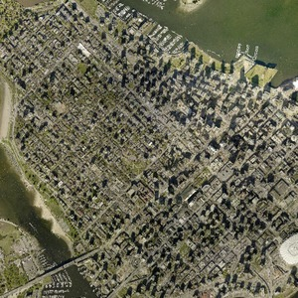
Raster data is data that is presented in a grid of pixels. Each pixel within a raster has a value, whether it be a colour or unit of measurement, to communicate information about the element in question. Rasters typically refer to imagery. However, in the spatial world, this may specifically refer to orthoimagery which are photos taken from satellites or other aerial devices. Raster data quality varies depending on resolution and your task at hand.

